Slide 1
Chapter 4_2 Energy, Heat, Work, and Power of the Body
Dr rafid albadr |

Slide 2
Energy Content of Body Fuel
The catabolic rate ΔU/Δt is therefore directly correlated with the consumption of oxygen.
Consumption of liter O2 gas since rate ≈ 4.8 kcal of energy

Slide 3
The energy produced per mass of fuel (energy released) is
686 kcal/180 g glucose = 3.80 kcal/g glucose.
calorific equivalent, the energy produced per liter of oxygen consumed, which is

Slide 4
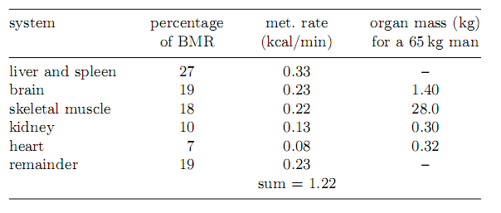
Metabolic Rates
Basal Metabolic Rate
The basal metabolic rate (BMR) is that of an inactive, awake body.
The BMR is a function of mass, height, and gender, The BMR for a 70 kg person is about 1,680 kcal/day ∼70 kcal/h ∼81 W

Slide 5
Metabolic Rates
The BMR is a function of mass, height, and gender, The BMR for a 70 kg person is about 1,680 kcal/day
There is a way that the BMR scales with a physical attribute of size, specifically the body mass m_{b}.
where c ≈ 90 kcal/kg^{3/4}-day. This is known as Kleiber’s Law

Slide 6
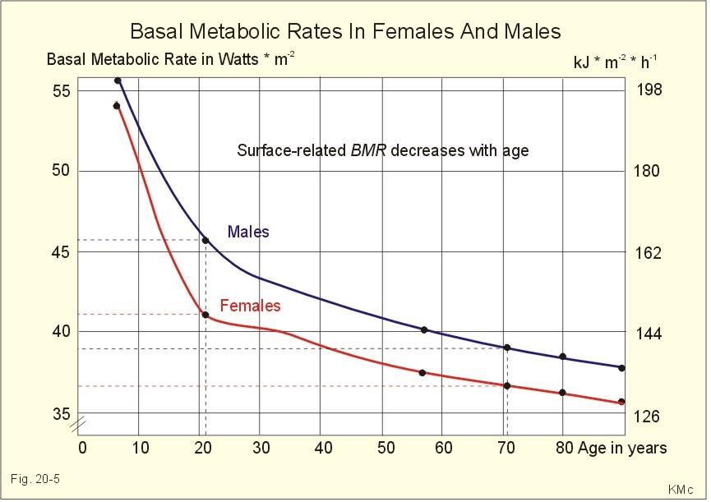
Metabolic Rates

Slide 7
Loss of Body Heat
heat capacity C, which is the heat required to raise the temperature T of an object by 1ºC.
The heat capacity C is the specific heat (expressed per unit mass) × the total object mass m

Slide 8
Loss of Body Heat

Slide 9
Loss of Body Heat
verage human specific heat is c = 0.83 kcal/kg-ºC
Mass m_{b} = 70 kg
Consider the BMR of an m_{b} = 70 kg person, which is ∼1,680 kcal/day= 70 kcal/h
Without heat losses and body temperature control the body temperature will increase between 1.2 and 24 °C per hour depending on the active level. Therefore heat loss and temperature control mechanisms are necessary.

